Slide 1

Cyclic Inflation
Pre-Planckian Inflation
Tirthabir Biswas
With Mazumdar & Koivisto, arXiv:1105.2636 [astro-ph.CO]
With Mazumdar & Shafieloo, Phys.Rev. D82 (2010), arXiv:1003.3206 [hep-th]
With Mazumdar, Phys Rev D 80, (2009), arXiv:0901.4930 [hep-th]
With Alexander, Phys Rev D 80, (2009), arXiv:0812.3182 [hep-th]

Slide 2
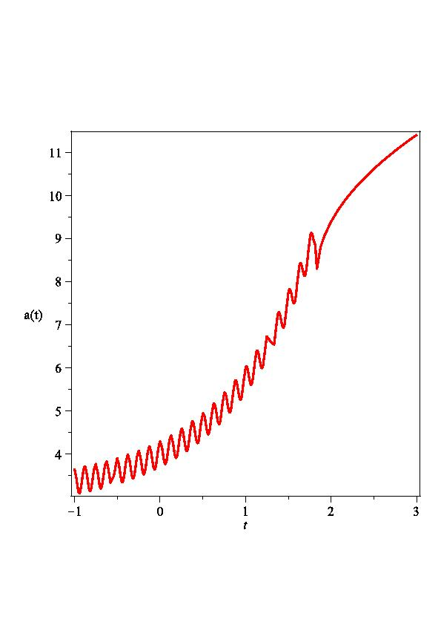
Background Cosmology
Asymetric cyclic evolution
In each cycle the universe grows a little more than it contracts
Cycles are very short:
Underlying conjecture:
Universe bounces back at a critical
Planckian density, ρ_{c}
Details of bounce mechanism may not
be important “observationally”
Goodies from Inflation
Old cosmological puzzles are solved
One obtains nearly scale invariant spectrum!

Slide 3
Specific Realizations:
Universe begins with -Λ [Linde et. al.]
In presence of radiation, it leads to periodic evolution
If there is more than one forms of matter which interact, entropy is produced.
  This is a consequence of 2nd law thermodynamics
  Typically this leads to overall growth [Tolman, 1931]
  Universe expands a little more than it contracts.
Grows by the same factor – Inflation

Slide 4
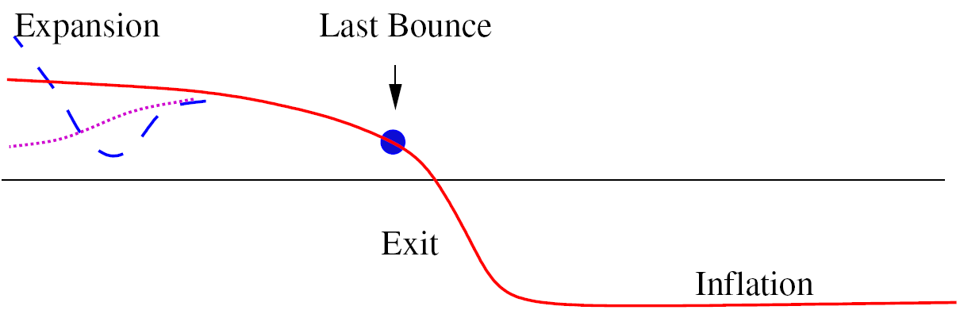
Is a Graceful Exit possible?
Yes
During contraction, kinetic energy blue shifts, & total energy increases [Linde et. Al.]
Once K + V >0, can only turn back in the +ve region
If the universe bounces back, may not be able to escape!
Success depends on parameters and IC’s?

Slide 5
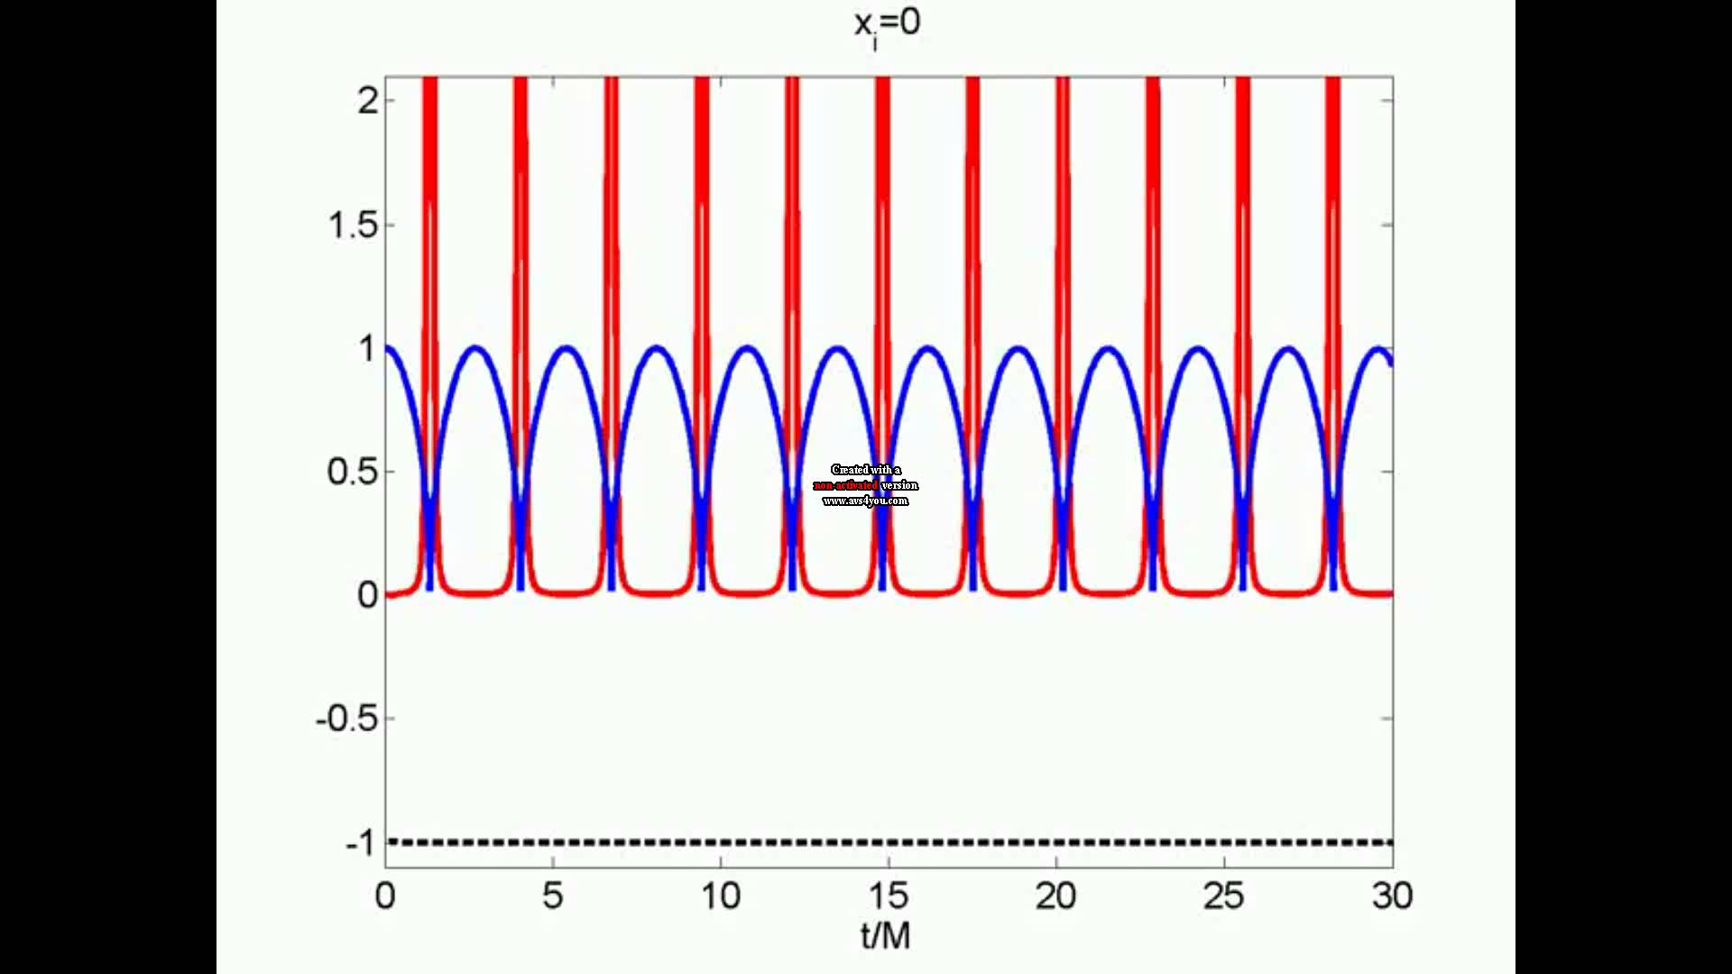

Slide 6
Periodic Scale-Invariance
Analyzing perturbations looks like a daunting task
There is a very general argument for near scale-invariance.
Evolution of fluctuations depend only on and {ρ_{i}(λ)} for a given comoving mode
  deSitter gives exact scale invariance
  Inflation has a tilt
  k and (1+κ) k have same {ρ_{i}(λ)} leading to periodic scale-invariance
A crude approximation is to calculate the amplitude at the last exit.

Slide 7
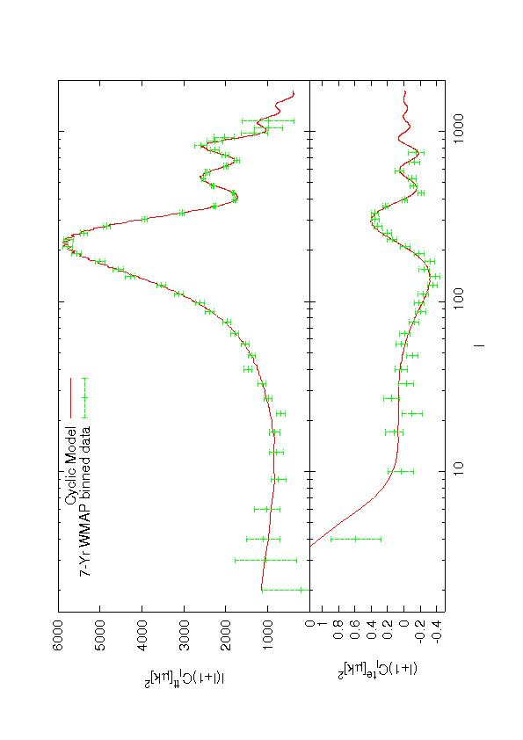
Signatures in CMB
Amplitude determined by time scale of cycle
Tilt of the spectrum depends on slope of potential
Distinctive signature: periodic modulations in ln(k)
Produces a pretty good fit to the 7-yr data
2 additional parameters consistent with improvement of
Wait for Planck satellite

Slide 8
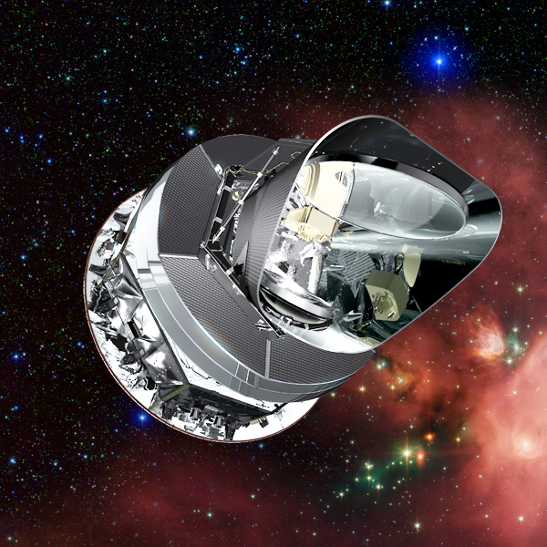
Outlook
Cyclic Models provide interesting alternatives to inflation, but it’s very challenging to live without inflation.
Cyclic Inflation seems an interesting compromise, although rigorous perturbation analysis is still pending.
Cyclic Inflation can be made past geodesically complete, no beginning of time
CMB signatures, what about non-gaussianity?
Planck mission
might have something to say

Slide 9
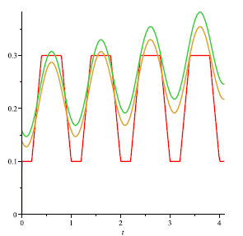
Perturbations
A priori looks like a daunting task
There is a very general argument for near scale-invariance
Power-spectrum depends on
energy densities at the
Hubble crossing
At the last Hubble crossing

Slide 10
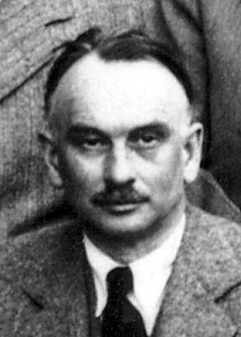
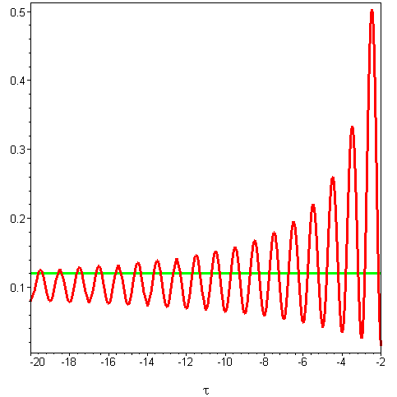
Emergent Cyclic Universe
Tolman’s Entropy Problem
Entropy is monotonically increasing
Universe atmost quasi-periodic
Entropy (Energy, period) vanishes
in a finite time in the past
Beginning of time – back to square 1
Thermal Hagedorn Phase, T=T_{H} ~ M_{S}
All string states in thermal equilibrium
entropy constant
As cycles shrink, universe is hotter
less time in entropy producing non-Hagedornic phase
more time in Hagedorn phase
Cycles assymptote to a constant entropy periodic evolution

Slide 11
Classic Puzzles
Flatness, Largeness & Entropy : Just like inflation
curvature ~ a⁻² , diluted away
Small “spatially curved” patch expands just
like inflation to resemble our universe
Tolman’s problem: initial emergent phase
Isotropy: Anisotropy ~ a⁻⁶
Anisotropy wins chaotic Mixmaster behavior
Ekpyrotic models successfully address this problem, ρ_{ekp} wins
Cyclic Inflation: If we start with an initial smooth patch, it only becomes more isotropic over cycles. No Mixmaster behavior.
Homogeneity/ Blackhole overproduction
Matter domination, structures grow, since gravity is always attractive.
Sub Hubble modes don’t grow significant radiation ⇒
For Super Hubble modes

Slide 12
Is a Graceful Exit possible?
Yes
During contraction,
kinetic energy blue shifts,
& total energy increases
Once K + V >0, can only turn
back in the +ve region
If the universe bounces back,
may not be able to escape!
Success depends
on parameters
and IC’s?

Slide 13
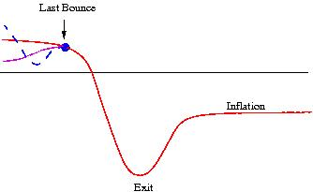
How to exit from Cyclic-Inflation?
Graceful Exit Problem
Eventually we want a long expanding phase
In this short cycles no time to even form nucleus, atoms!
Turnaround requires a –ve CC, we live in small +ve CC
How to exit?
Introduce a scalar potential
Kinetic energy increases during
contraction
Increase depends on slope
Total energy can go from – ve to + ve
Once +ve, field cannot turn around
Can zoom past the minimum and into + ve potential region

Slide 14
Could the Universe have started with Negative potential Energy?
It seems to be in obvious contradiction with current observation
Early Universe (Inflation) requires positive energy as well
In GR, during expansion scalar energy density can only decrease
Nevertheless String Theory predicts Negative Energy Regions
No apriori reasons why it didn’t begin with negative energy
Inflation is not past geodesically complete [Borde,Vilenkin,Linde,1994]
So what happens if we have - Λ?
As long as matter density is larger than Λ, we can do cosmology
Universe is not stuck at an AdS vacuum, -Λ facilitates a turnaround
In GR this results in a Big Crunch, but…
A conjecture: Universe bounces back at a critical Planckian density
Cyclic Universe Multiple bounces & “Turnarounds”
Cycles are very short:

Slide 15
Background Cosmology
If there is more than one forms of matter which interact, entropy is produced
This is a consequence of 2nd law thermodynamics [Tolman, 1931]
Typically this leads to overall growth
Universe expands a little more than it contracts.
Grows by the same factor – Inflation

Slide 16
CMB Summary
Amplitude
determined by time scale of cycle
Spectrum
Distinctive signature: periodic modulations in ln(k)
Produces a pretty good fit to the 7-yr data
w.r.t. Standard Inflationary model without wiggles
2 additional parameters consistent with improvement of
Can Planck shred some light?

Slide 17
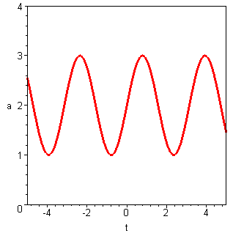
Cyclic Cosmologies: Good, Bad & Ugly
Good
Cyclic Models solve the Horizon problem
There is no beginning of time
Time is past and future eternal
Non-singular and geodesically complete
Finding new models is good science
Bad
Problems with homogeneity/isotropy
Reproducing CMB Fluctuations
  Correct amplitude requires huge asymmetry
  Getting scale-invariant spectrum have proved extremely challenging
Ugly
Transferring fluctuations from the contracting to the expanding branch
Cyclic Universe
Einstein,Freedman,
Tolman, Lemaitre 30’s
Bondi,Gold,Narlekar
& Hoyle (Steady State) 50’s
Steinhardt & Turok (ekpyrotic), ’02
TB, Mazumdar
& Shafeloo (Cyclic-Inflation)

Slide 18
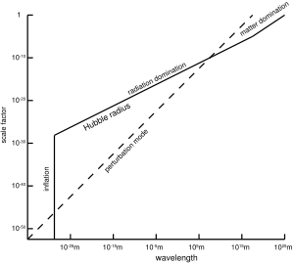
Transferring fluctuations via bounce
Inflation, V’’(Φ)≈0, a~-1/Hτ
Sub-Hubble
Super-Hubble
Matching at Hubble crossing
Power Spectrum
Ekpyrotic
Generates scale-invariant spectrum in the “growing mode” during contraction phase.

Slide 19
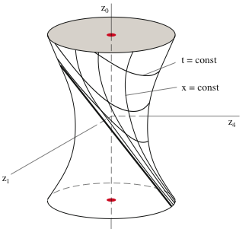
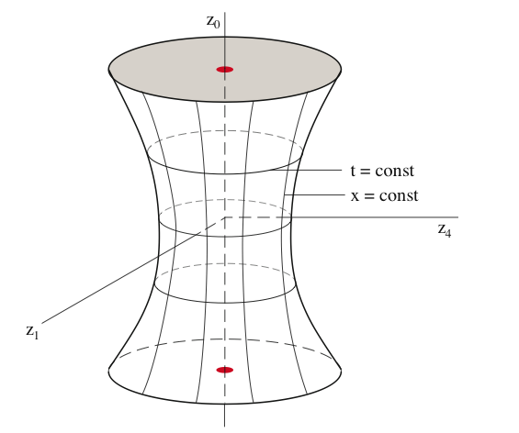
Why should we care about Cyclic Cosmologies?
Can we avoid the beginning of time ?
Standard Cosmological Model
Can Inflation be past-eternal? [Guth,Vilenkin,Borde,Linde]
Ordinary GR takes you back
to singularity
  QG Phase, no geometry
  Space-time continuum as 0th order approximation
QG may give us a
“Big Bounce”
Flat/Open: DEC,WEC violation
Open or flat:
geodesically
incomplete
Closed: geodesically complete

Slide 20
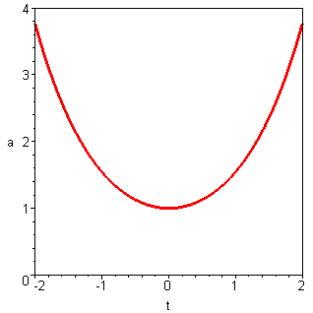
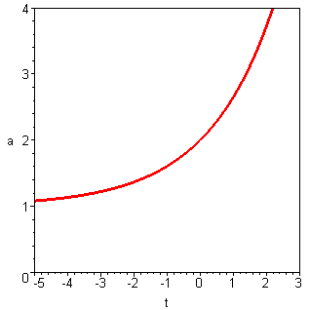
Non-singular Cosmologies
“Effective” 4D metric description
Stick to FLRW cosmologies: BKL conjecture
Look into the “eternal past”
Bouncing Universe Emergent Universe Cyclic Universe
Novello,Salim; Melnikov,Orlov,70’s Ellis & Maartens ’04 Einstein,Freedman,Tolman,Lemaitre, 30’s
Gaperini, Maggiore & Veneziano Bondi,Gold,Narlekar,Hoyle (steady state) 50’s
(pre-big bang) ’97 Steinhardt ,Turok,Ovrut,Khoury (ekpyrotic)

Slide 21
CMB Fluctuations
Inflation
Perturbed metric λ∝a
Start from “sub-Hubble fluctuations”
wavelength << cosmological expansion
They oscillate
Starting from Bunch Davis vacuum
During inflation they become super-Hubble and freeze
Amplitude
Explains why you have near scale-invariant spectrum

Slide 22
The Amplitude Problem
Bouncing universe/long cycle
Hydrodynamical fluctuations
Logical starting point at t = -∞
Vacuum initial conditions
Amplitude is suppressed
(if during bounce it remains frozen)
Symmetric bounce means trouble
Thermal Fluctuations:
Fixing this require asymmetry
Ekpyrotic Scenario: slow contraction → normal expansion
Inflation: normal contraction → fast expansion
Don’t need exponential inflation,
no trans-Planckian problem, spectral break – unique signature
Generating fluctuations over many many cycles

Slide 23
2nd Law of Thermodynamics &
Tolman’s Entropy Problem
Tolman’s Observations
Entropy is monotonically increasing
Universe atmost quasi-periodic
Entropy (Energy, period) vanishes in a finite time in the past
Or the universe is again geodesically complete
Beginning of time – back to square 1
Can we use 2nd law to generate asymmetry?
Suppose around bounce, we have thermal equilibrium between some heavy non-relativistic particles and massless modes
When T<T_{c} ~ M, thermal equilibrium is lost
Matter can decay into radiation
Entropy increases by a constant factor
So does the scale factor!

Slide 24
