Slide 1
Faculty 180 Overview
College of Arts and Sciences
Council of Chairs
October 3, 2016

Slide 2
Agenda
Background
Faculty 180
What is it?
What does it do?
What does it look like?
Faculty and university benefits
Implementation timeline
What do we have to do?
Pilot opportunity

Slide 3
background
Provost formed an ad hoc group of faculty and staff, charged with evaluating software packages that can track faculty research activities
Group considered eight systems, participated in two software demonstrations
Primary concerns included
Usability
Implementation and data input
Reporting features
Consensus of the group was to strongly recommend Faculty 180 for institution-wide implementation

Slide 4
What is Faculty 180?
Software system designed to improve the collection and reporting of faculty credentials and activity data
Tracks teaching, research, scholarship, creative works, professional and institutional service activities, community engagement…
Single, convenient place for faculty members to archive their achievements
Reduces faculty time responding to requests for information
Facilitates completion of reports associated with accreditation, grant applications…

Slide 5
What does faculty 180 do?
Faculty credentials
Activity reporting/workload
Curriculum vita
Annual evaluations
Promotion and tenure
Sabbatical requests
Accreditation compliance

Slide 6
What does faculty 180 Look LIKE?
Dashboard
Profile
Activities

Slide 7
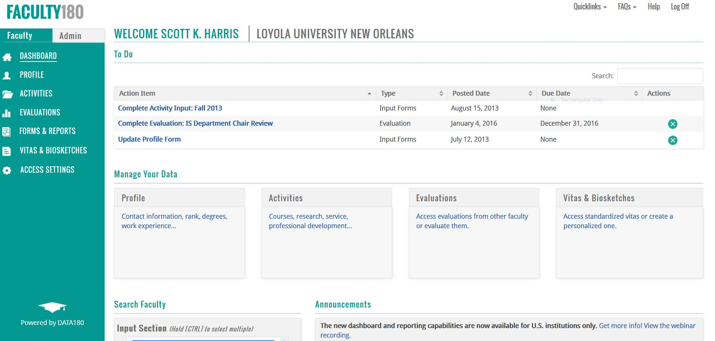

Slide 8
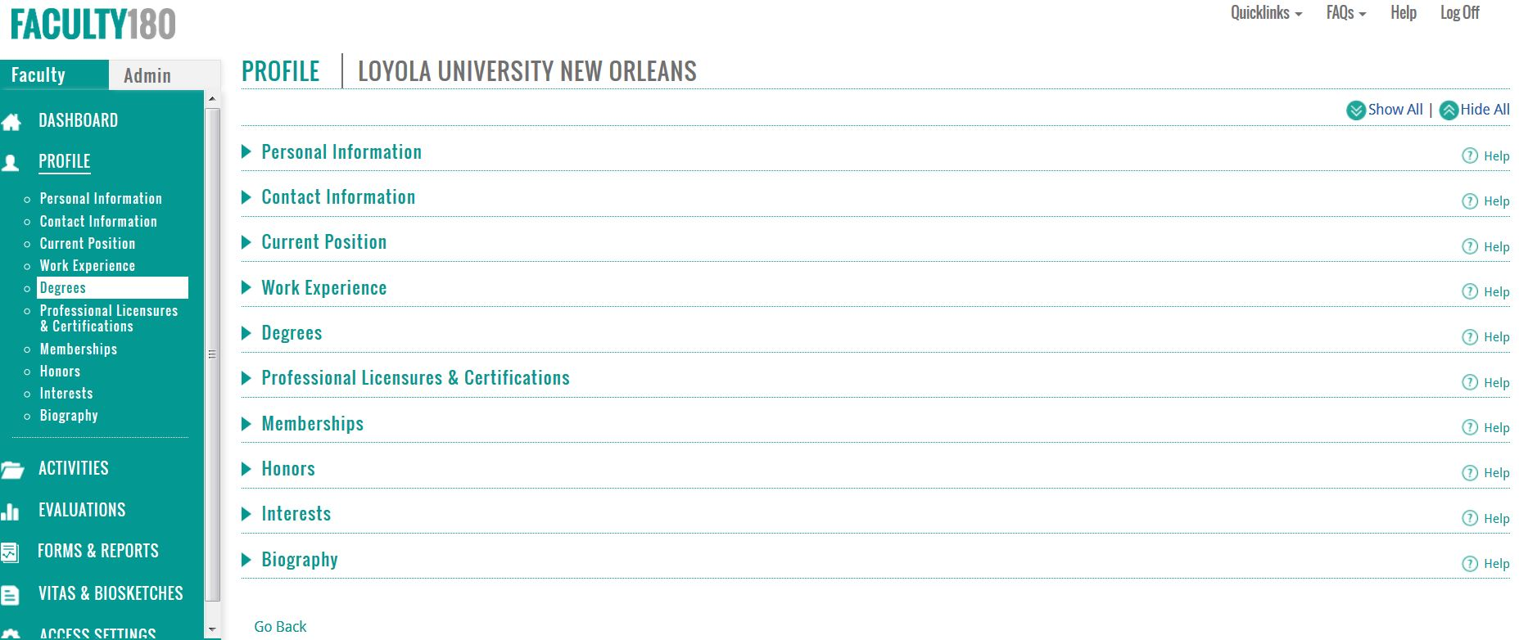

Slide 9
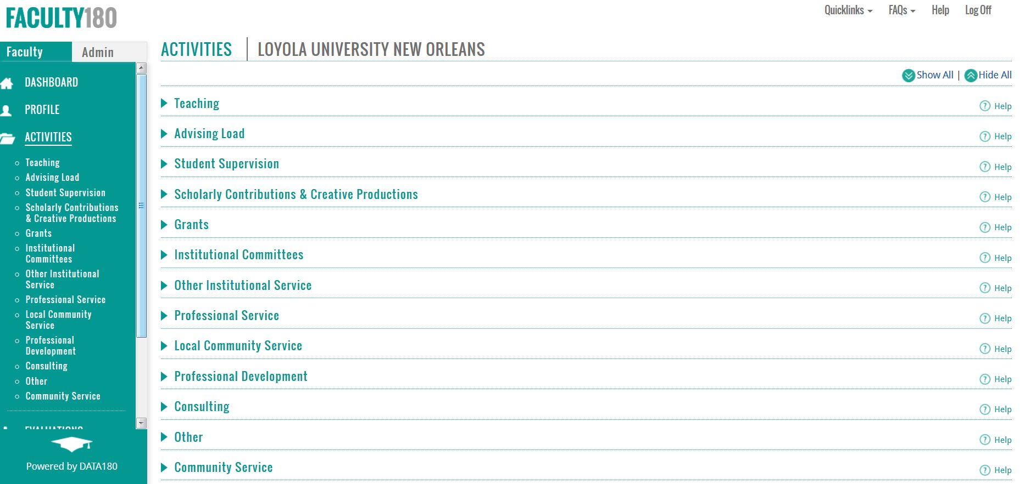

Slide 10
Faculty benefits
Save time collecting data and responding to requests for information
Manage data in one location to minimize redundancy
Integrates with reference management software (e.g., Zotero) and bibliographic citation databases (e.g., EBSCO)
Benefit from having faculty and course data downloaded from campus system (SIS)
Input credentials and activities once to support the data needs of administrators, accrediting bodies, and other stakeholders
Share CVs, performance data, and supporting documents for annual reviews, p/t decisions, etc.
Support grant applications with documented accomplishments (e.g., CVs, NIH and NSF biosketches)
Access metrics of individual performance as a basis for reflection and improvement

Slide 11
University benefits
Facilitate credential match between instructor and courses taught
Ensure that credentials are stored in a secure, centralized location
Improve ability to generate reports of faculty activity at the department, college and institutional levels
Improve ability of units to link faculty activity/accomplishment data to
annual reporting
institutional effectiveness and assessment processes
professional accreditation reporting
Calculate workload, research, service and professional development activities
Complete annual faculty evaluations
Mediate promotion/tenure applications, post-tenure review and sabbatical requests
Improve efficiency of faculty related processes

Slide 12
Implementation timeline
Fall 2016
Initial system implementation
Spring 2017
Faculty training
Summer 2017
Customize system with faculty feedback
Fall 2017
Faculty training
Data input (all)
Data input (pilot)
Upload base data sets

Slide 13
What do we have to do?
University Responsibilities
Upload faculty and course files each semester
Bulk data entry for implementation
Train faculty, chairs and deans
Provide ongoing support
Faculty Responsibilities
Full-time faculty:
access to their account in the system 24/7/365
required to update their activities each semester (at minimum)
Adjunct faculty:
credentials and teaching assignments will be uploaded
not required to maintain an account

Slide 14
Pilot participation
Seeking:
Open-minded faculty interested in technology and reporting
Obligations
Overview and training
Review individual information in the system, revise and update as necessary
Provide feedback
Informal meetings
Focus group
Survey
Incentives
Opportunity to give detailed feedback and help customize the system
Benefit of lots of hand holding
Head start on a task that all full-time faculty will be required to do the following fall

Slide 15
Learn more
http://www.data180.com/faculty180.php

