Slide 1
Revising the Common Curriculum
College of Humanities and Natural Sciences
February 26, 2015

Slide 2
Common Curriculum Core Competencies
The goal of the Common Curriculum is to foster students’ competency in five key areas:
Critical Thinking
Effective Communication
Quantitative Reasoning
Information Literacy
Ethical Reasoning

Slide 3
The Common Curriculum Fall 2013
Introductory (21 cr) | Advanced (24-25 cr) | Language (up to 12 cr) | RACs (0 cr)
First-Year Seminar | Writing about Literature | A100 | Catholic Tradition
ENGL T122 Critical Reading & Writing | HIST II | A101 | Diversity
MATH T122 Math Models or MATH A115 Intro to Finite Math or MATH A257 Calculus I | PHIL II – Foundations of Knowledge | A200 | Premodern
HIST T122 Global History I or HIST T124 Global History II | RELS II | A201
PHIL T122 Phil of the Human Person | Natural Science in Context
RELS T122 Religions of the World or RELS T124 Christianity and Society | Engaging in Science: Lab (1 cr)
SCIE T129 Investigating Nature | Social Science
 | Creative Arts and Cultures (2-3 cr)
 | Foundational Ethics |  | TOTAL: 57-58 CREDITS

Slide 4
The Common Curriculum revised Fall 2013
Introductory (21 cr) | Advanced (24-25 cr) | Language (up to 12 6 cr) | RACs (0 cr)
First-Year Seminar | Writing about Literature | A100 Placement | Catholic Tradition
ENGL T122 Critical Reading & Writing | HIST II | A101 Placement +1 | Diversity
MATH T122 Math Models or MATH A115 Intro to Finite Math or MATH A257 Calculus I | PHIL II – Foundations of Knowledge | A200 | Premodern
HIST T122 Global History I or HIST T124 Global History II | RELS II | A201
PHIL T122 Phil of the Human Person | Natural Science in Context
RELS T122 Religions of the World or RELS T124 Christianity and Society | Engaging in Science: Lab (1 cr)
SCIE T129 Investigating Nature | Social Science
 | Creative Arts and Cultures (2 3 cr)
 | Foundational Ethics |  | TOTAL: 57-58 51 CREDITS

Slide 5
Elective-challenged majors
Eligibility
12 or fewer General Electives in degree program
additional content in the major and/or reduction in general education (i.e., Common Curriculum) coursework justified by accreditation requirements and/or best practices in the discipline
% of students enrolled in elective-challenged majors | First-Year | Sophomore
Humanities and Natural Sciences | 42.4% | 40.5%
Social Sciences | 0% | 0%
Business | 100% | 100%
Music and Fine Arts | 85.8% | 76.5%
Total | 55.9% | 52.8%
Figures based on data provided by the Office of Institutional Research and Effectiveness. See “Enrollment by Major with Registered Hours,” September 30, 2014, http://academicaffairs.loyno.edu/sites/academicaffairs.loyno.edu/files/pf5%20enrollment-by-major-wth-reg-hrs-final-9%2030-1.pdf.

Slide 8
Current challenges
The revision process led to a larger, more complex Common Curriculum.
Lack of commonality creates difficulties in planning courses.
Lack of commonality creates difficulties in conducting meaningful assessment. SACS-COC requires that the general education component of an undergraduate degree program be “based on a coherent rationale” (2.7.3).
Lack of commonality makes “Common Curriculum” a misnomer.
RAC designations have been applied inconsistently to courses; these requirements place additional burdens on already strained degree programs in business and the natural sciences, where there are fewer options for satisfying RACs within the major.
The complexity of the Common Curriculum poses challenges to advising and results in students taking additional coursework unnecessarily; DPCLs are inconsistent, illogical, and illegible in some cases.

Slide 9
Current challenges
Distinction between “Introductory” and “Advanced” Common Curriculum courses is sometimes arbitrary.
 | FALL 2013 |  |  |  |  | SPRING 2014
COURSE | FR | SO | JR | SR | TOTAL | FR | SO | JR | SR | TOTAL
Engl-T122 | 178 | 83 | 16 | 4 | 281 | 203 | 39 | 16 | 7 | 265
Hist-T122 | 252 | 118 | 37 | 8 | 415 | 92 | 28 | 18 | 8 | 146
Hist-T124 | 55 | 115 | 34 | 20 | 224 | 33 | 81 | 31 | 15 | 160
Math-T122 | 54 | 24 | 9 | 2 | 89 | 48 | 23 | 13 | 12 | 96
Phil-T122 | 194 | 244 | 55 | 15 | 508 | 206 | 91 | 40 | 11 | 348
Rels-T122 | 145 | 150 | 34 | 17 | 346 | 134 | 54 | 21 | 9 | 218
Relt-T124 | 93 | 17 | 9 | 1 | 120 | 20 | 9 | 4 | 3 | 36
Scie-T129 | 89 | 122 | 44 | 16 | 271 | 93 | 77 | 39 | 21 | 230
 | 1060 | 873 | 238 | 83 | 2254 | 829 | 402 | 182 | 86 | 1499
 | FALL 2014 |  |  |  |  | SPRING 2015
COURSE | FR | SO | JR | SR | TOTAL | FR | SO | JR | SR | TOTAL
Engl-T122 | 205 | 48 | 7 | 7 | 267 | 171 | 34 | 13 | 9 | 227
Hist-T122 | 225 | 73 | 29 | 11 | 338 | 106 | 37 | 19 | 33 | 195
Hist-T124 | 48 | 30 | 40 | 17 | 135 | 26 | 19 | 28 | 23 | 96
Math-T122 | 40 | 27 | 10 | 5 | 82 | 57 | 13 | 12 | 12 | 94
Phil-T122 | 186 | 87 | 29 | 8 | 310 | 218 | 72 | 46 | 16 | 352
Rels-T122 | 146 | 70 | 25 | 7 | 248 | 145 | 41 | 28 | 4 | 218
Rels-T124 | 7 | 38 | 10 | 9 | 64 | 50 | 9 | 7 | 5 | 71
Scie-T129 | 50 | 115 | 67 | 28 | 260 | 133 | 43 | 43 | 31 | 250
TOTAL | 907 | 488 | 217 | 92 | 1704 | 906 | 268 | 196 | 133 | 1503

Slide 10
Common elements across all degree programs*
First-Year Seminar
Critical Reading and Writing
Math Models
Global History
Philosophy of the Human Person
Religious Studies (World Religions or Christianity)
Investigating Nature
Writing about Literature
Foundational Ethics
Catholic Tradition RAC
Diversity RAC
Premodern RAC
TOTAL – 27 credits (0 cr for RACs)
* Not included: MUTY, MUED, and Evening Division

Slide 11
College re-structuring
Beginning in Fall 2016
all degree programs that currently have a 51-credit Common Curriculum will be housed in the reconstituted College of Arts and Sciences;
all College of Business degree programs will continue to require 39 credits of Common Curriculum coursework;
all College of Music and Fine Arts degree programs will require 39 credits of Common Curriculum coursework following an anticipated revision of the remaining theater and visual art programs.

Slide 12
Recommendation #1: Establish a standard 39-credit core curriculum for all* undergraduate degree programs for Fall 2016.
Foundations Courses – 9 hours
First Year-Seminar
ENGL T122 Critical Reading and Writing
Knowledge Courses – 21 hours
HIST T122 Global History I or HIST T124 Global History II
PHIL T122 Philosophy of the Human Person
Values Courses – 9 hours
Foundational Ethics
MATH T122 Math Models or MATH A115 Intro to Finite Math or MATH A257 Calculus I
RELS T122 Religions of the World or RELS T124 Christianity and Society
Natural Science
Writing about Literature
Creative Arts and Cultures
Social Science
Catholic Tradition
Diversity
Foundations Courses must be completed in the first year.
Knowledge Courses include disciplinary and inter-/multidisciplinary coursework.
Values Courses have PHIL T122 or RELS T122/T124 as a prerequisite.
*Not included: MUTY, MUED, Evening Division

Slide 13
Recommendation #2: Develop additional college-, division-, or program-level requirements as appropriate.
Common Curriculum – 39 cr | Bachelor of Arts Core – 21 cr | HIST Major – 34 cr | General Electives – 26 cr
First-Year Seminar | PHIL II | HIST T124 | General Elective
ENGL T122 | RELS II | HIST A200 | General Elective
MATH T122 | SCIE II | HIST A201 | General Elective
HIST T122 | Foreign Language A100 | HIST A202 (1 cr) | General Elective
PHIL T122 | Foreign Language A101 | U.S. History Elective | General Elective
RELS T122/T124 | Foreign Language A200 | European History Elective | General Elective
SCIE T129 | Foreign Language A201 | Non-US/Euro History Elective | General Elective
WAL |  | Non-US/Euro History Elective | General Elective
CAC |  | History Elective | General Elective (2 cr)
SS |  | History Elective
Ethics |  | History Elective
Catholic Tradition |  | HIST A400
Diversity

Slide 14
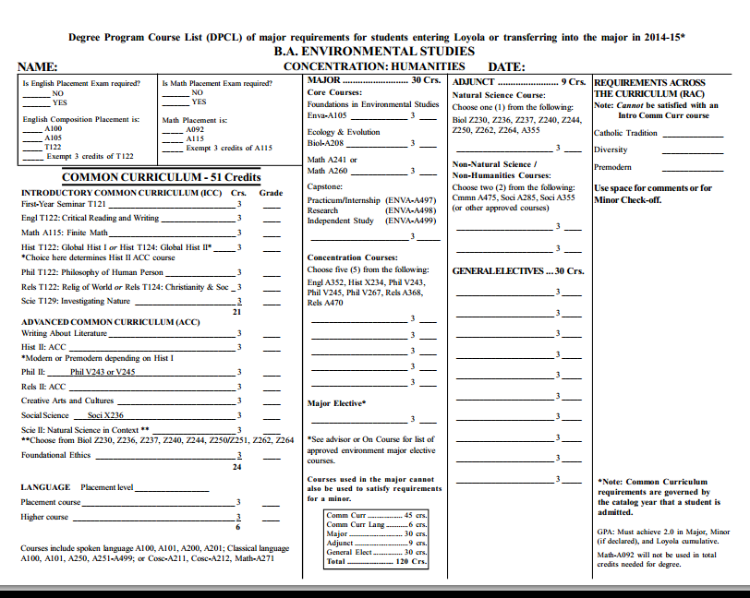

Slide 15
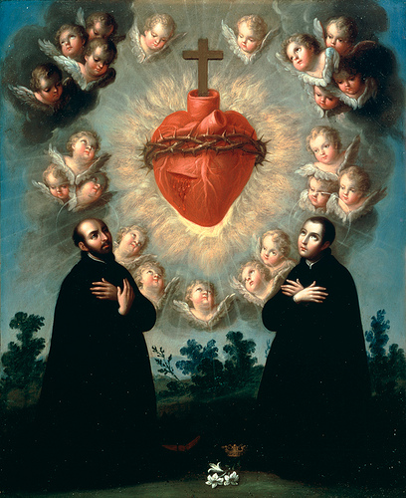
Recommendation #3: Rename the Common Curriculum the Loyola Core.
José de Páez, Sacred Heart of Jesus with Saint Ignatius of Loyola and Saint Aloysius Gonzaga (1770)

Slide 16
Questions, comments, or rude remarks?

