Slide 1

Nonlocal Field Theories & Gravity
Perimeter Institute 2012
Tirtho Biswas

Slide 2
My Collaborators
N. Barnaby (U of M)
R. Brandenberger (McGill)
J. Cembranos (Madrid)
J. Cline (McGill)
M. Grisaru (McGill)
J. Kapusta (U of M)
T. Koivisto (Utrecht)
A. Kosheylev (BrusselNs)
A. Mazumdar (Lancaster)
A. Reddy (U of M)
W. Siegel (Stony Brook)
S. Vernov (Moscow)
TB, J. Cembranos and J. Kapusta,
PRL 104, 021601 (2010)
[arXiv:0910.2274 [hep-th]]
TB, E. Gerwick, T. Koivisto and A. Mazumdar,
PRL 108, 031101 (2012)
[arXiv:1110.5249 [gr-qc]]

Slide 3
My Motivation
Standard Models of Particle Physics & Cosmology have been remarkably successful
Too successful, no experimental puzzles
Hints at new meV physics (Dark energy & Neutrinos)
Fall back on theoretical prejudices
  Hierarchy problem, Unification - GUT, SUSY, String Theory
  Nonsingularity – can we use this to guide us?
Higher derivative actions are better behaved in UV, can they be ghost-free? [Moffat, Modesto…]

Slide 4
Outline
Nonlocal Field Theory
  Stringy Motivations
  Ghostfree higher derivative theories
  Finite Loops & some results
Nonlocal Gravity
  The problem of Ghosts
  Nonsingular Black Holes?
  Nonsingular Cosmology?

Slide 5
Stringy Inspiration
p-adic strings:
open string coupling prime number string tension
The N-point tree amplitudes of the open string can be
generated from a non-local p-adic Lagrangian.
Volovich, Brekke, Freund, Olson, Witten, Frampton, Okada, late 80’s

Slide 6
String Field Theory type:
Related cousins
Strings on Random lattice
[Douglas & Shenker, Gross & Migdal, 1990]
Noncommutative Field theory
Theory of unparticles
Tachyons in String Field Theory: [Witten,Sen]
Particle Phenomenology: [Moffat, Woodard…]

Slide 7

Interesting Properties
Ghostfree
But SFT/padic type theories have no extra states!
Quantum loops are finite
UV under better control, like usual HD theories
All loops, all p’s and even sums remain finite and can be calculated explicitly using the usual Feynman rules

Slide 8
Applications
Insights into string theory
Brane Physics & Tachyon condensation [Zwiebach & Moeller; Forini, Gambini & Nardelli; Colleti, Sigalov & Taylor; Calcagni…]
Hagedorn physics [Blum; TB, Cembranos & Kapusta]
Spectrum [TB, Grisaru & Siegel, Minahan]
Applications to Cosmology
Novel kinetic energy dominated non-slow-roll inflationary mechanisms [TB, Barnaby & Cline; Lidsey…]
Large nongaussianities [Barnaby & Cline]
Dark Energy [Arefeva, Joukovskaya, Dragovich, ...]
Applications to Particle Physics [Moffat et.al., Ooguri & Mende, Nobuchika]

Slide 9
Insights into String Theory
String Thermodynamics is supposed to exhibit
“Hagedorn Phase transition” & “Thermal duality”
[Attick & Witten, Vafa & Brandenberger, Tseythlin]
Can we use thermal p-adic field theory?
and non-local propagator
with dimensionful coupling constant

Slide 10
2-loop & Thermal Duality
Compute Feynman diagrams
p=3

Slide 11
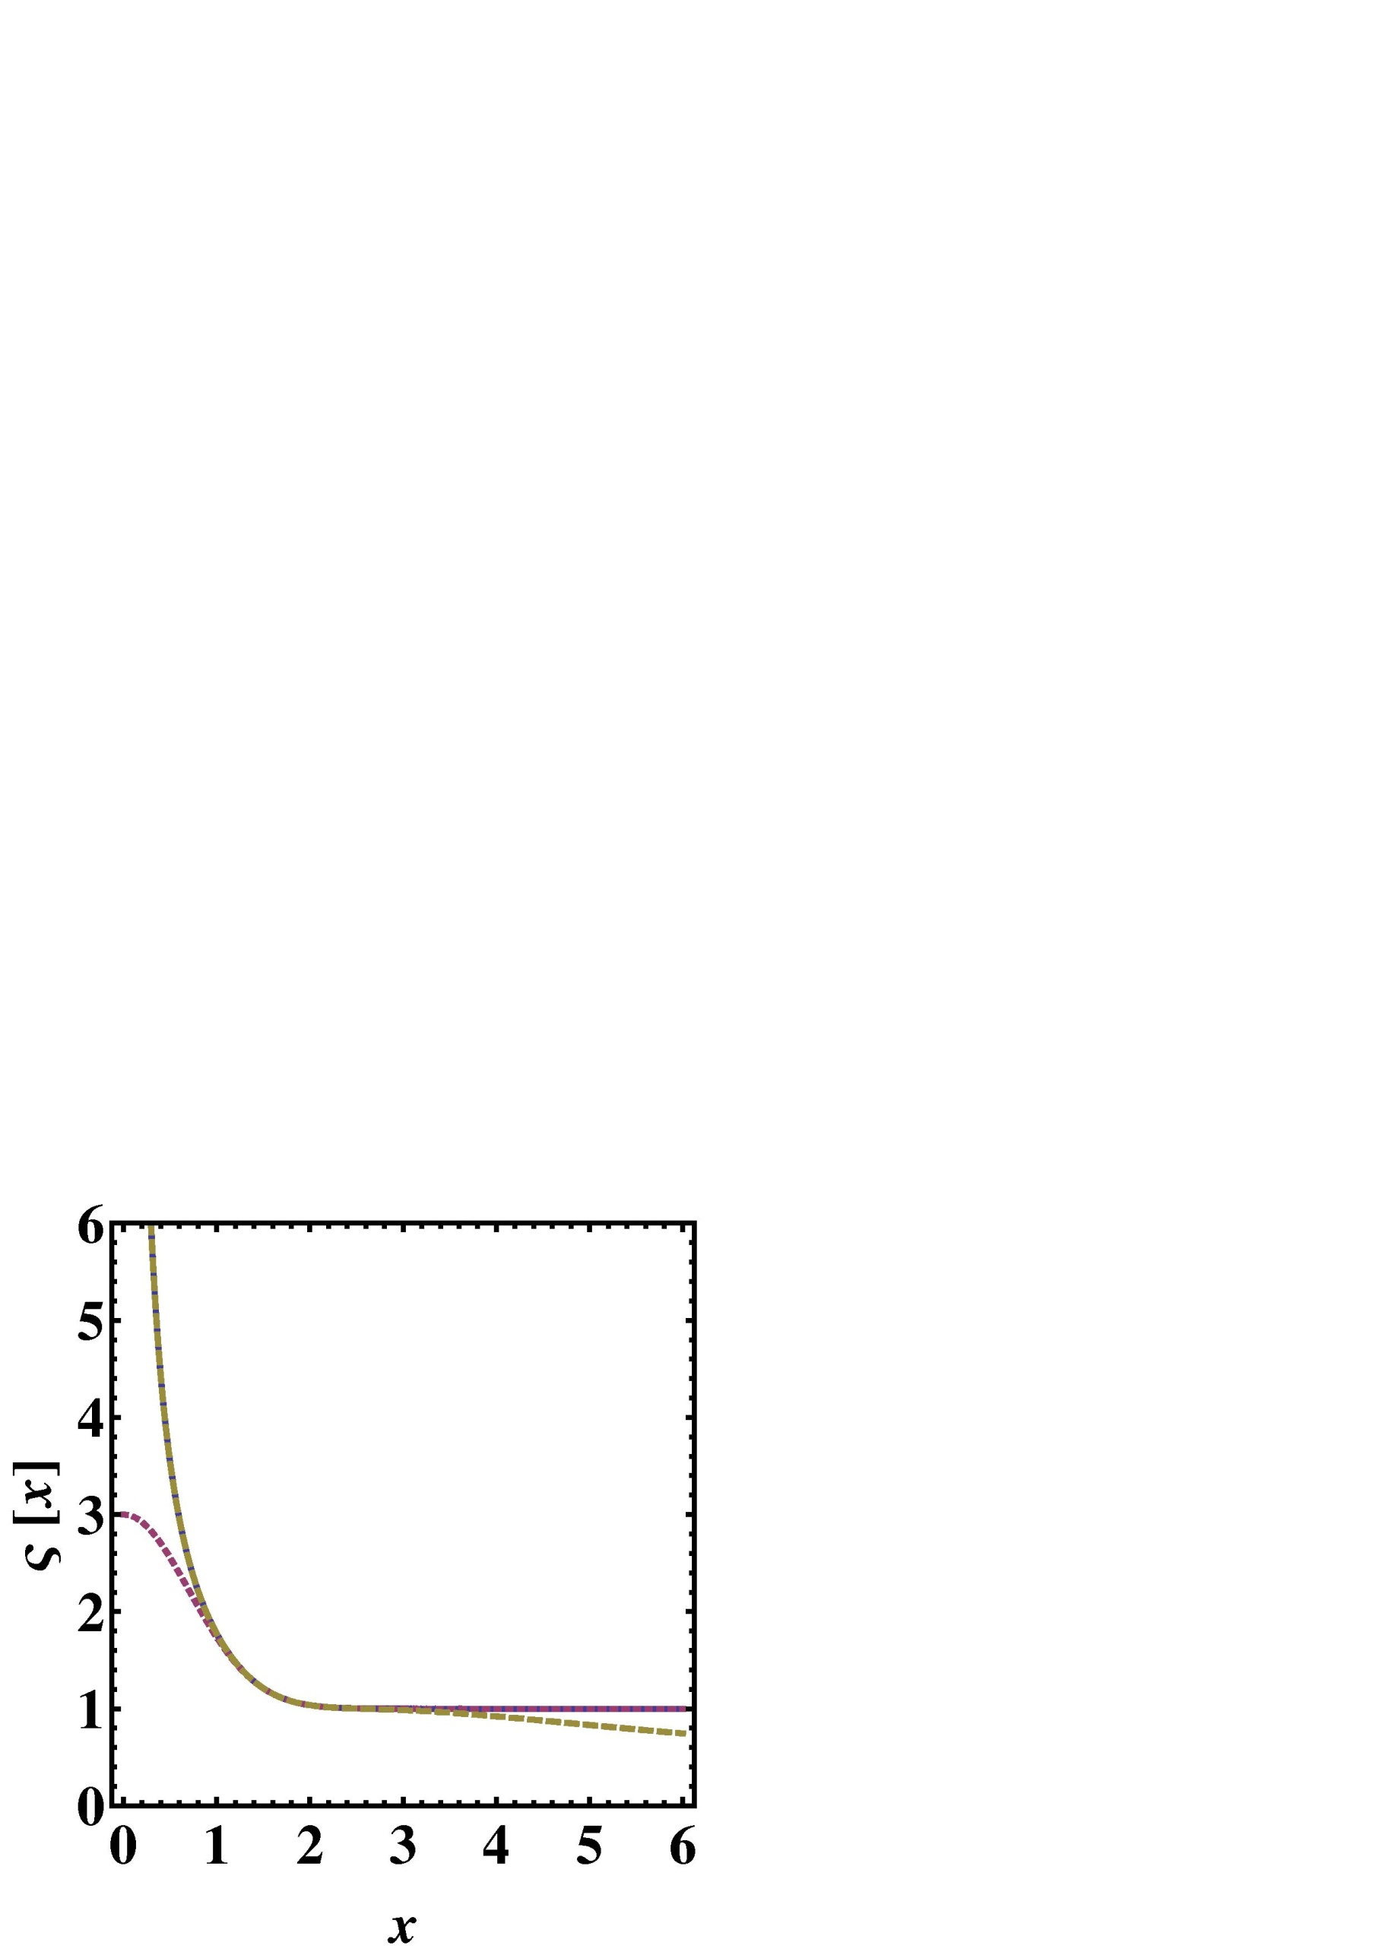
Stiff-fluid Hagedorn Phase
[Atick & Witten]
Matter dominated Phase
[Vafa & Tseytlin]

Slide 12
Summary
Infinite series higher derivative actions pop out in string theory
They seem to be consistent
Have novel properties
Have applications in String Theory, particle Physics & Cosmology
Lot’s to be done!

Slide 13
Nonlocal Gravity
Can Nonlocal higher derivative terms be free from ghosts?
Can they address the singularity problems in GR ?
What about quantum loops? [Moffat, Modesto…]
  Stelle demonstrated 4th order gravity to be renormalizable (1977), but it has ghosts

Slide 14
Ghosts
From Scalars to Gravity
The metric has 6 degrees (graviton, vector, and two scalars)
Gauge symmetry is subtle, some ghosts are allowed
Several Classical (time dependent) backgrounds.

Slide 15
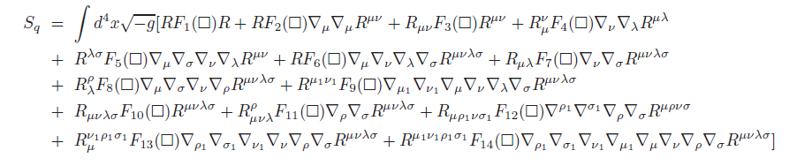
Ghostfree Gravity
Free from ghosts in Minkowski vacuum
Only interested in quadratic action [with Mazumdar, Koivisto, Gerwick, 2012 PRL]
Naively 14 combinations possible
Covariant derivatives must be Minkowski, only 2 arbitrary fns

Slide 16
Using
  Bianchi identities
  antisymmetric properties of Reimann &
  commutator of covariant derivatives
only 3 linearly independent combinations survive
Some stringy calculations suggests the Gauss-Bonnet term

Slide 17
Covariant derivatives must be Minkowski
  a + b = 0
  c + d = 0
  a + c + f = 0
Follows from conservation of stress energy tensor

Slide 18
By inverting Field equations we obtain the propagators
Decouple the different multiplets using projection operators, [van Nieuwenhuizen]
Bianchi identities dictates the propagator is of the form
  In GR a = c = 1, scalar ghost cancels the longitudinal mode
  a has to be an entire function, otherwise Weyl ghosts
  a-3c can have a single zero -> f(R)/Brans-Dicke theory
  Exponential non-local Gravity,

Slide 19
Newtonian Potentials
Large r, reproduces gravity; small r, asymptotic freedom
Gravity Waves
Similar arguments imply nonsingular Green’s functions for quadrupole moments

Slide 20
Emergent Cosmology
Space-time begins with pure vacuum
You cannot find a consistent solution for GR
There must be a scalar degree of freedom

Slide 21
Exact Solutions
Bouncing Solutions
deSitter completions, a(t) ~ cosh(Mt)
Stable attractors, but there are singular attractors.
Can provide a geodesically complete models of inflation.
Perturbations can be studied numerically and analytically, reproduces GR at late times [in progress]

Slide 22
Conclusions
Nonlocal gravity is a promising direction in QG
It can probably solve the classical singularities
How to constrain higher curvatures?
  New symmetries
  Look at ghost constraints on (A)dS – relevant for DE
Can we implement Stelle’s methods?

Slide 23
Interesting Properties
Ghostfree
But SFT/padic type theories have no extra states!
Quantum loops are finite
UV under better control, like usual HD theories
Linear Regge Trajectories [TB, Grisaru & Siegel]
Thermal duality [TB, Cembranos & Kapusta, 2010 PRL]
Can there be any phenomenological implications for LHC?

Slide 24



t’ Hooft dual to string theory
Polyakov action:
Strings on Random lattice [Douglas,Shenker]
Dual Field theory action
Linear Regge trajectories: Confinement [Grisaru, Siegel, Y.T.]

